Slide 1


Experiment 1
Delta-Delta Transformer – Balanced Operation
Dr. Norbert Doerry and Dr. John V. Amy Jr.
http://doerry.org/norbert/MarineElectricalPowerSystems/index.htm
© 2024 by Norbert Doerry and John Amy
This work is licensed via: CC BY 4.0 (https://creativecommons.org/)

Slide 2
Schematic
5.2 : 1
208V
40V
C_{p} = 2.2 µF
R = 1200 Ω
R_{L} = 300 Ω
Notes:
Delta delta transformers are common shipboard
Today we will explore steady state characteristics in an ungrounded system
The components we will investigate are
three phase power supply
delta-delta transformer
parasitic capacitance to ground
wye-connected resistors for a neutral connection
delta connected load resistors

Slide 3
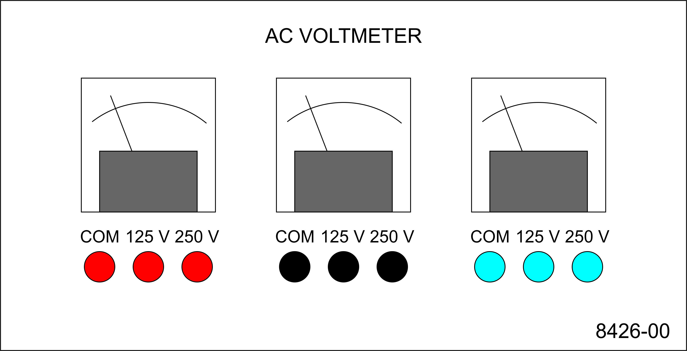
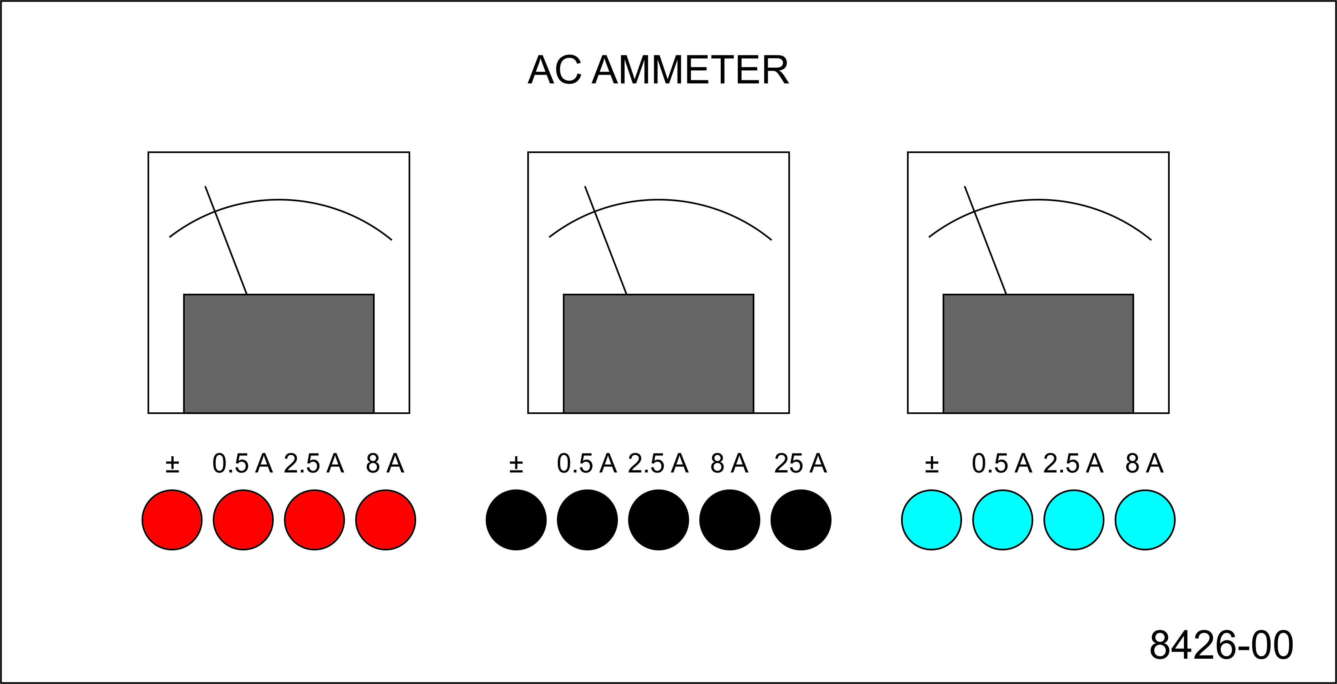
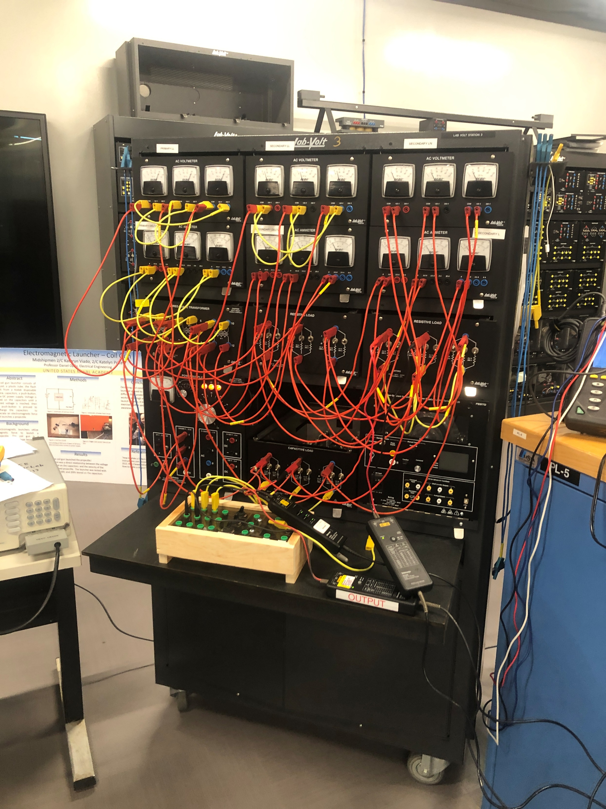
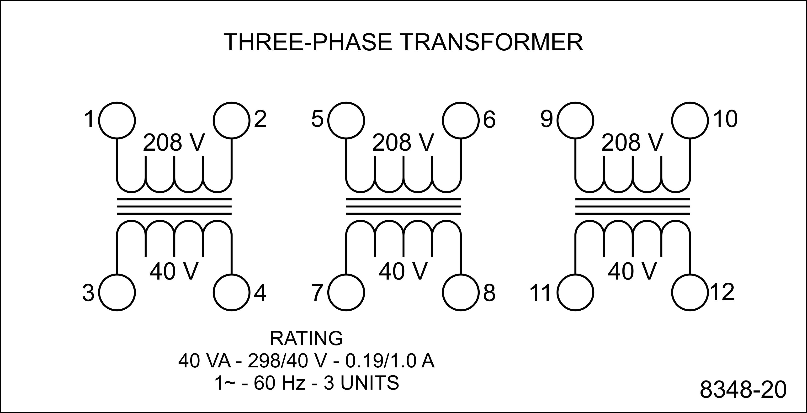
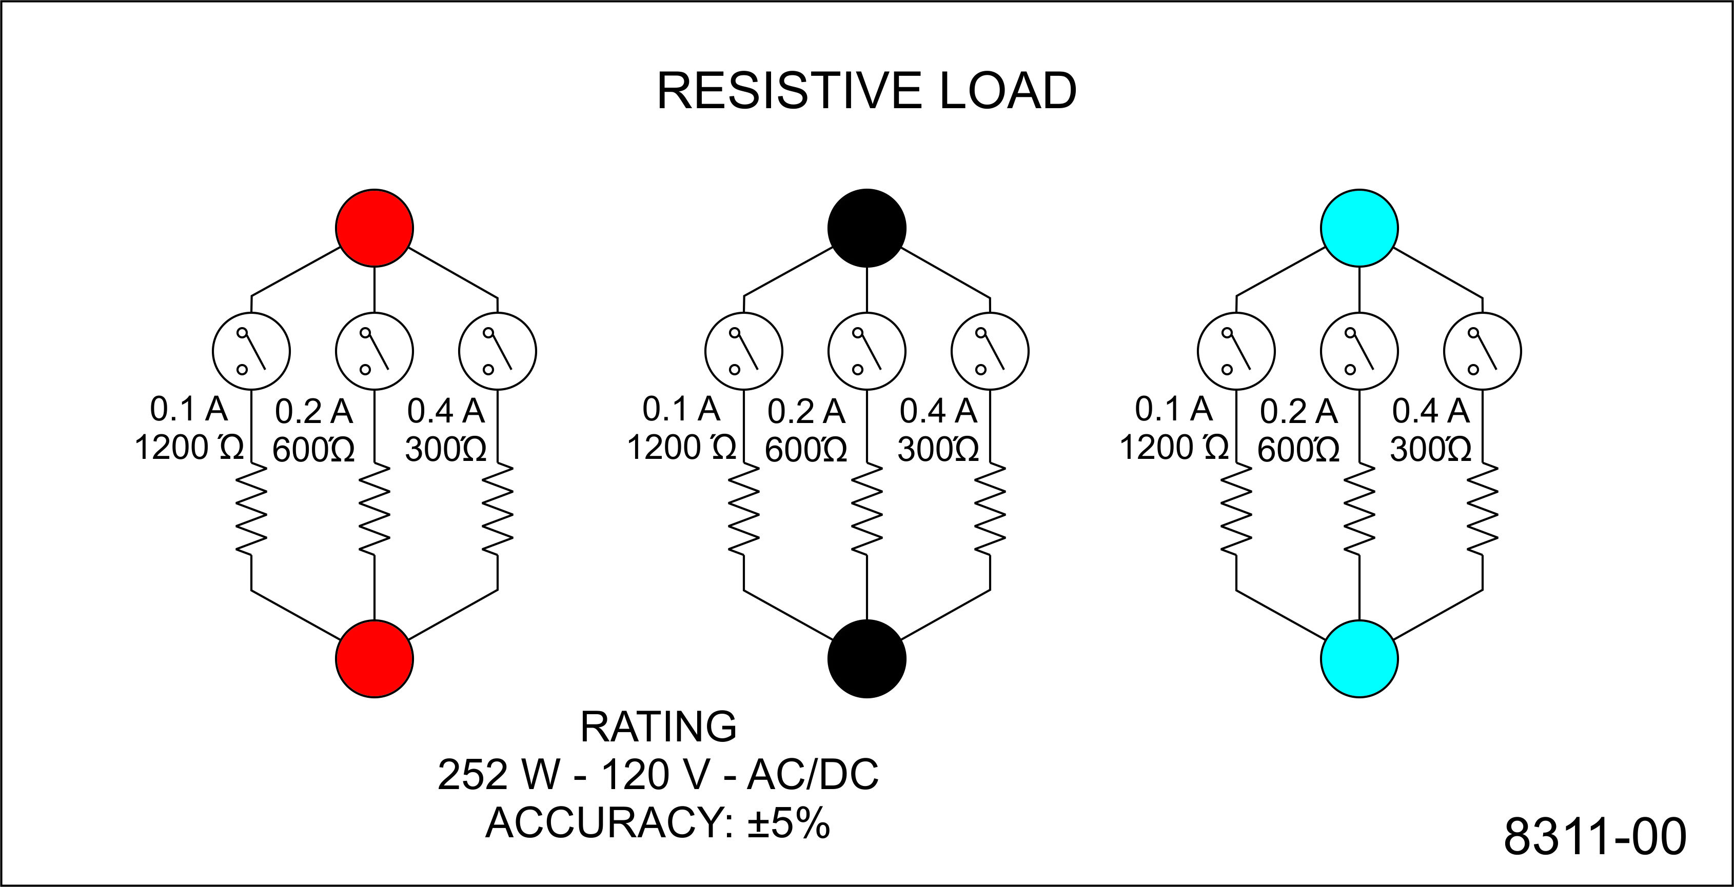
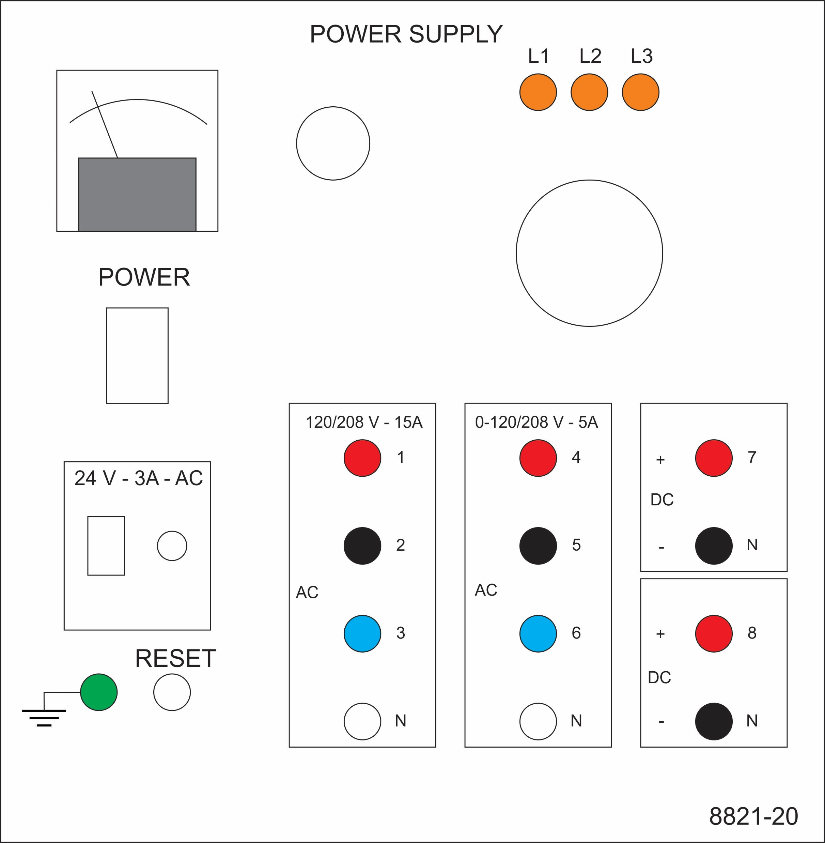
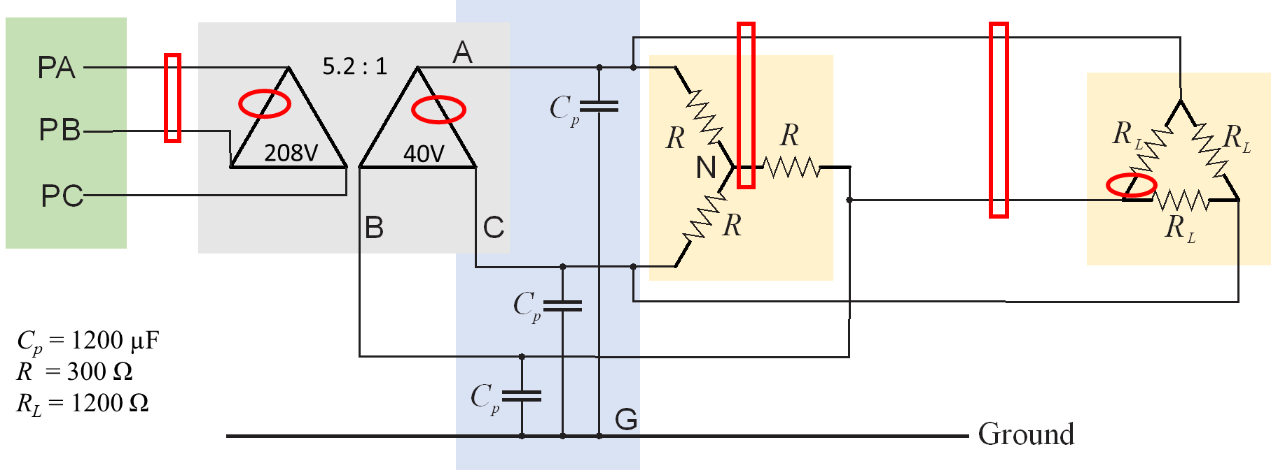
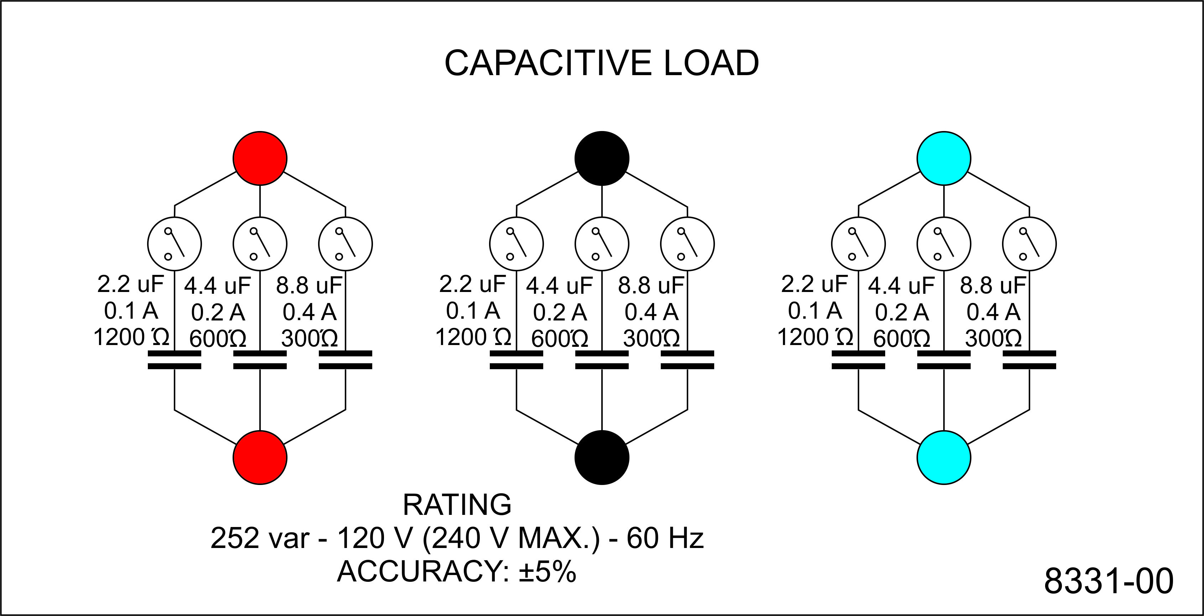
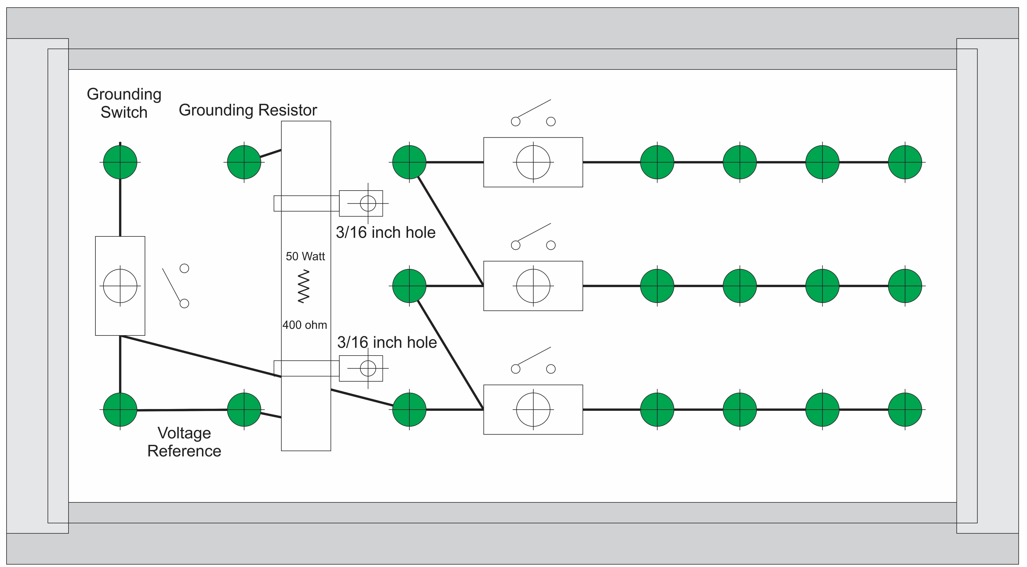
Experiment 1
Primary - LL
Secondary - LL
Secondary - LN
Primary - Delta
Secondary - Delta
Secondary - L
Delta
Wye
Parasitic

Slide 4
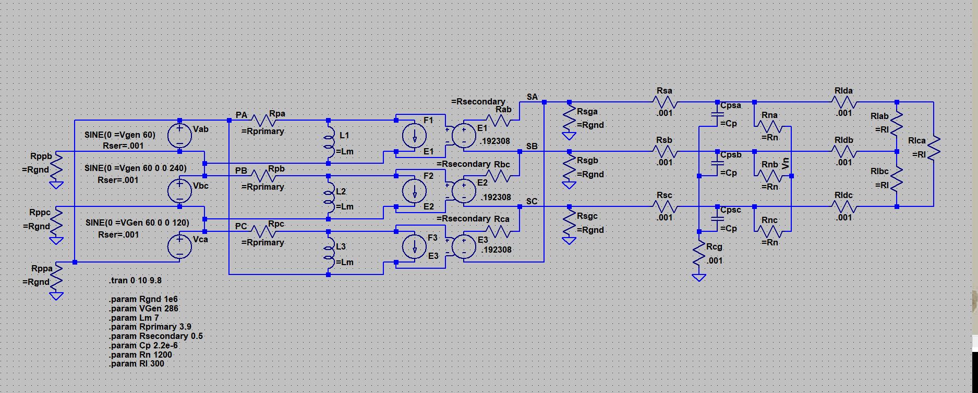
Simulation Model
LTspice XVII
20240727 experiment 1-nl.asc

Slide 5
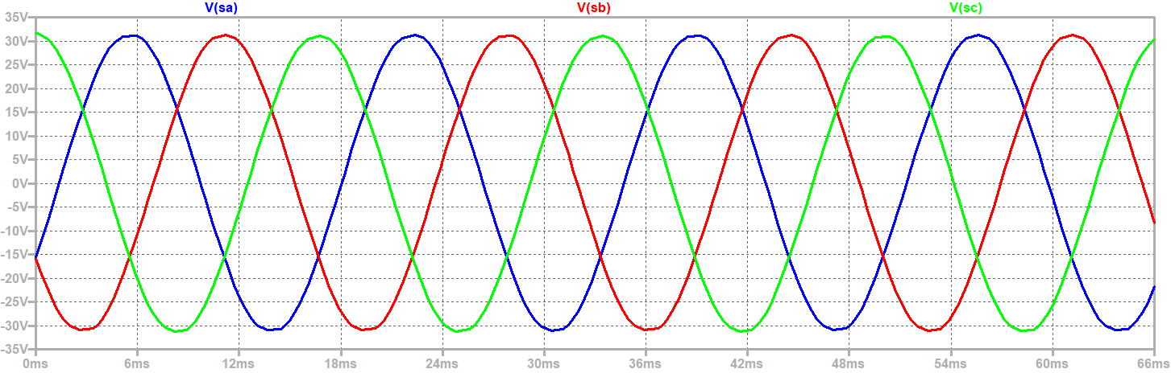
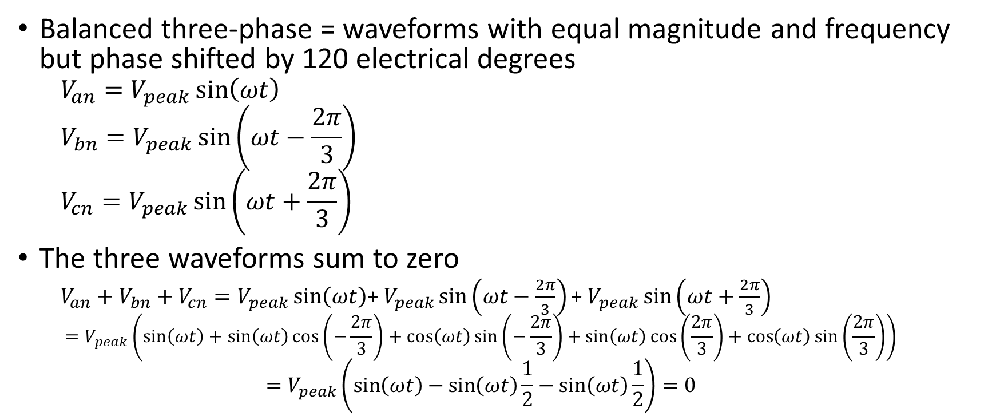
Three Phase Power Review
Balanced three-phase = waveforms with equal magnitude and frequency but phase shifted by 120 electrical degrees
  $$V_{an}=V_{peak}\sin\left(ωt\right)$$
  $$V_{bn}=V_{peak}\sin\left(ωt−\frac{2π}{3}\right)$$
  $$V_{cn}=V_{peak}\sin\left(ωt+\frac{2π}{3}\right)$$
The three waveforms sum to zero
  $V_{an}+V_{bn}+V_{cn}=V_{peak}\sin\left(ωt\right)\text{+ }V_{peak}\sin\left(ωt−\frac{2π}{3}\right)\text{+ }V_{peak}\sin\left(ωt+\frac{2π}{3}\right)$
  $$=V_{peak}\left(\sin\left(ωt\right)+\sin\left(ωt\right)\cos\left(−\frac{2π}{3}\right)+\cos\left(ωt\right)\sin\left(−\frac{2π}{3}\right)+\sin\left(ωt\right)\cos\left(\frac{2π}{3}\right)+\cos\left(ωt\right)\sin\left(\frac{2π}{3}\right)\right)$$
  $$=V_{peak}\left(\sin\left(ωt\right)−\sin\left(ωt\right)\frac{1}{2}−\sin\left(ωt\right)\frac{1}{2}\right)=0$$
Notes:
Balanced three phase definition

Slide 6
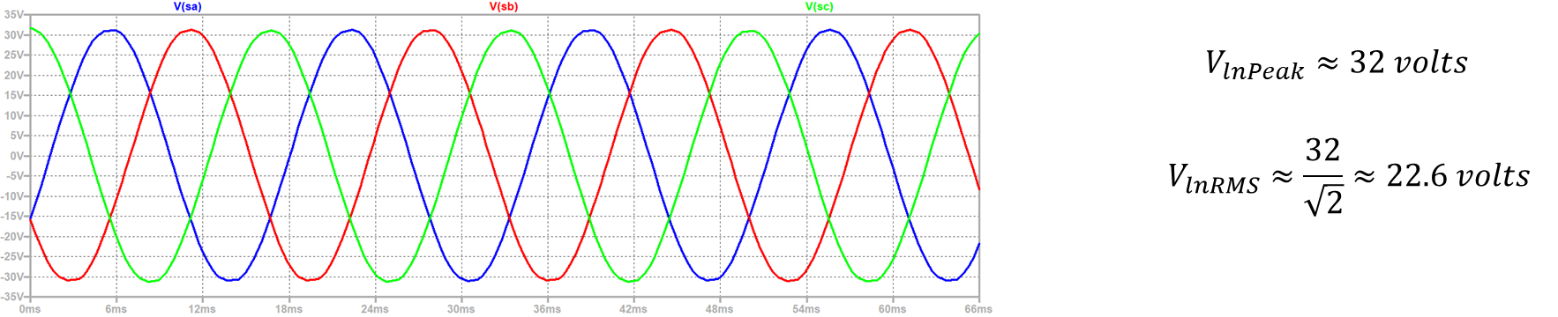

Three Phase Power Review
Peak value is $\sqrt{2}$times the root mean square (RMS) value
$$V_{rms}=\sqrt{\frac{1}{T}\int_{t=0}^{t=T}{{\left(V_{peak}\sin\left(ωt\right)\right)}^{2}dt}}$$
$$V_{rms}=\sqrt{\frac{V_{peak}^{2}}{Tω}{\left|\frac{ωt}{2}−\frac{1}{2}\left(sin\left(ωt\right){\cos\left(ωt\right)}\right)\right|}_{0}^{T}}=\frac{V_{peak}}{\sqrt{2}}$$
$$V_{peak}=\sqrt{2}V_{rms}$$

Slide 7
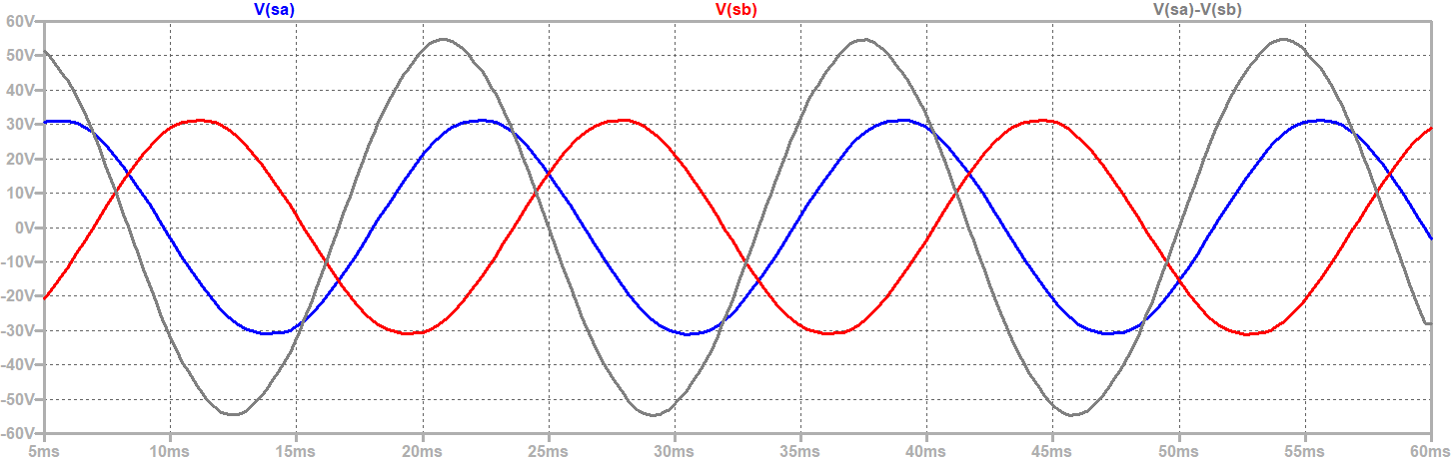
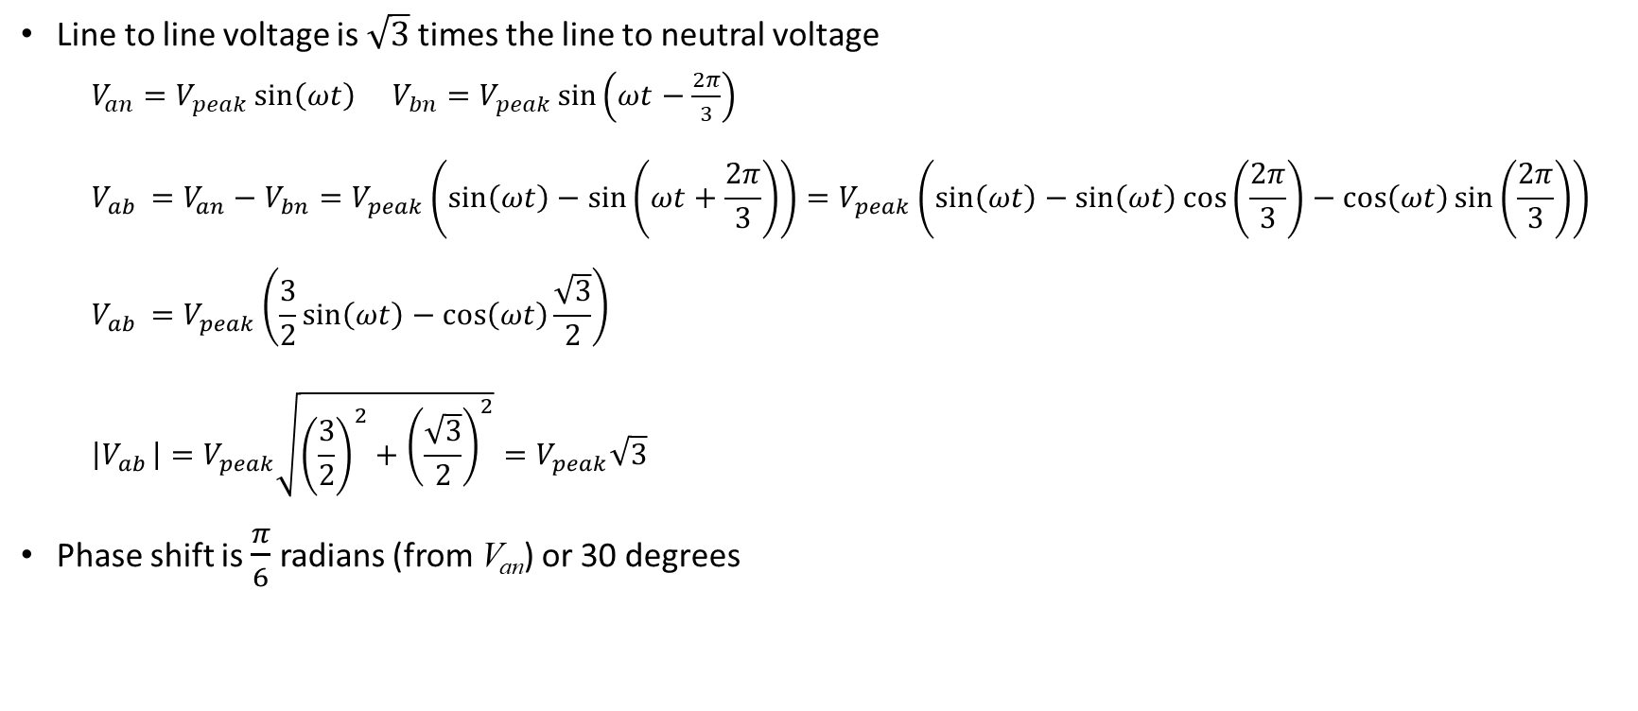


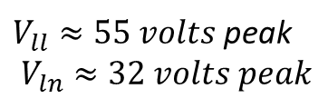
Three Phase Power Review
$V_{ll}≈55 volts$ peak
$$V_{ln}≈32 volts peak$$
$$\frac{55}{32}≈1.72$$
Line to line voltage is $\sqrt{3}$ times the line to neutral voltage
  $V_{an}=V_{peak}\sin\left(ωt\right)$ $V_{bn}=V_{peak}\sin\left(ωt−\frac{2π}{3}\right)$
  $$V_{ab }=V_{an}−V_{bn}=V_{peak}\left(\sin\left(ωt\right)−\sin\left(ωt+\frac{2π}{3}\right)\right)=V_{peak}\left(\sin\left(ωt\right)−\sin\left(ωt\right)\cos\left(\frac{2π}{3}\right)−\cos\left(ωt\right)\sin\left(\frac{2π}{3}\right)\right)$$
  $$V_{ab }=V_{peak}\left(\frac{3}{2}\sin\left(ωt\right)−\cos\left(ωt\right)\frac{\sqrt{3}}{2}\right)$$
  $$\left|V_{ab }\right|=V_{peak}\sqrt{{\left(\frac{3}{2}\right)}^{2}+{\left(\frac{\sqrt{3}}{2}\right)}^{2}}=V_{peak}\sqrt{3}$$
  Phase shift is $\frac{π}{6}$ radians (from V_{an}) or 30 degrees
$$\sqrt{3}≈1.73$$

Slide 8




Three Phase Power Review
Real Power
$$P=V_{an}I_{a}+V_{bn}I_{b}+V_{cn}I_{c}$$
$$P=V_{mag}\sin\left(ωt\right)I_{mag}\sin\left(ωt+θ\right)+V_{mag}\sin\left(ωt−\frac{2π}{3}\right)I_{mag}\sin\left(ωt−\frac{2π}{3}+θ\right)+V_{mag}\sin\left(ωt+\frac{2π}{3}\right)I_{mag}\sin\left(ωt+\frac{2π}{3}+θ\right)$$
After a lot of trigonometry ….
$$P=\frac{3}{2}V_{mag}I_{mag}\cos\left(θ\right)$$
Convert from peak to rms values for both current and voltage
$$P=3V_{lnrms}I_{rms}\cos\left(θ\right)$$
Convert from line to neutral voltage to line to line voltage
$$P=\sqrt{3}V_{llrms}I_{rms}\cos\left(θ\right)$$
$\cos\left(θ\right)$ = Power Factor
$$V_{llrms}≈39 volts$$
$$I_{rms}≈0.23 amps$$
$P≈15.5$Watts

Slide 9
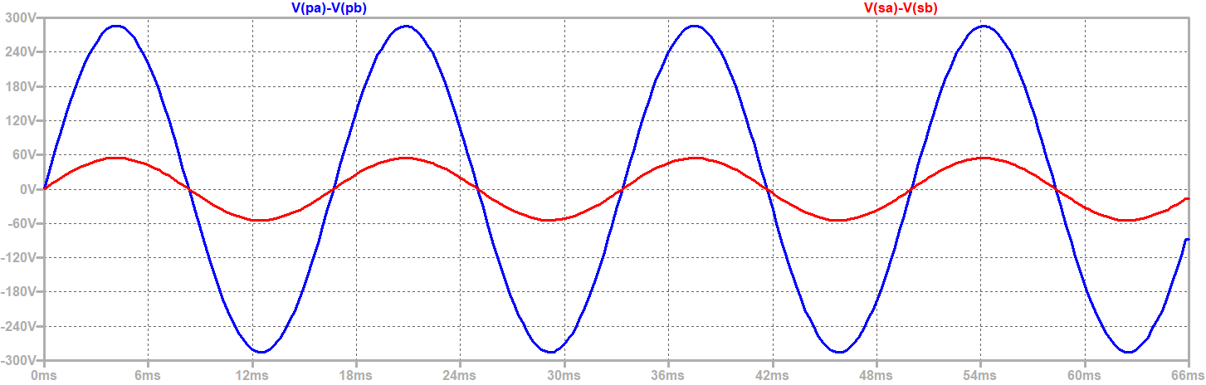
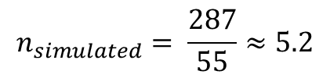
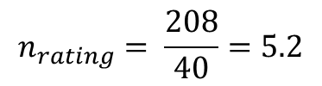
Transformer turns ratio is approximately the ratio of primary to secondary voltage
$$n_{rating}= \frac{208}{40}=5.2$$
$$n_{simulated}= \frac{287}{55}≈5.2$$

Slide 10
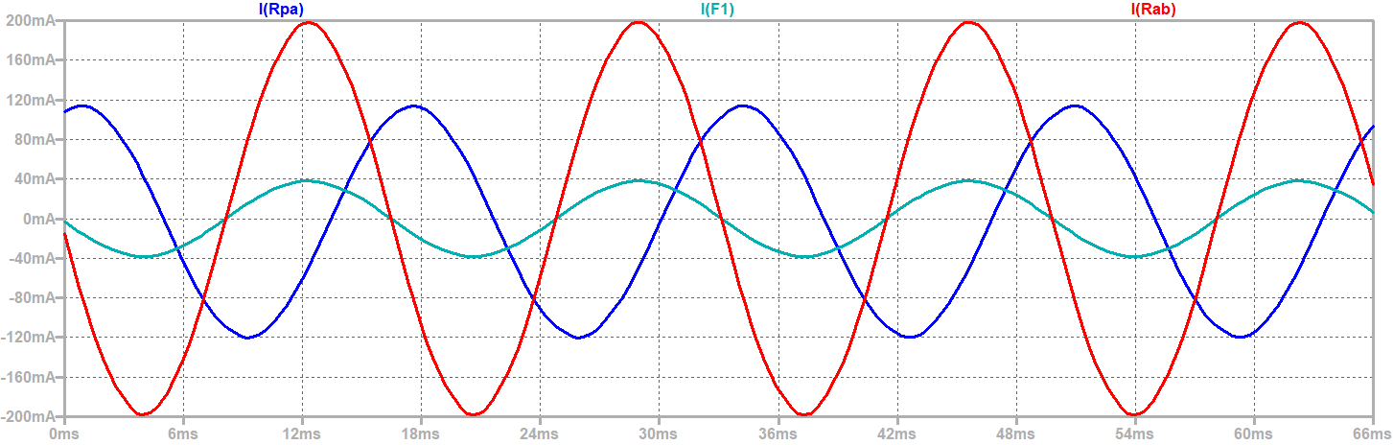

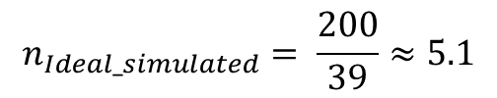
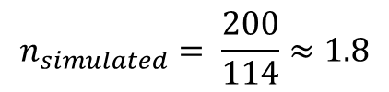
Ratio of currents not exactly the turns ratio
$$n_{rating}= \frac{208}{40}=5.2$$
$$n_{simulated}= \frac{200}{114}≈1.8$$
$$n_{Ideal_simulated}= \frac{200}{39}≈5.1$$

Slide 11
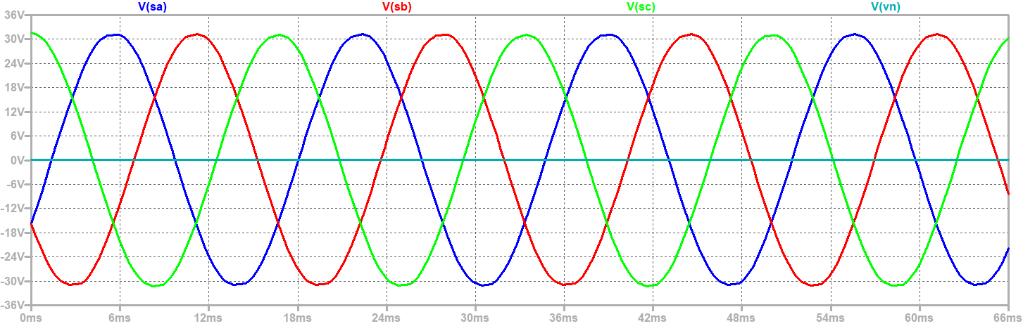

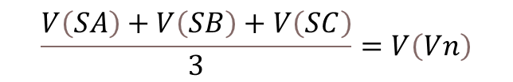
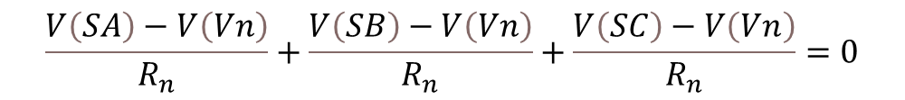
The neutral to ground voltage is zero for balanced operation
$$\frac{V\left(SA\right)−V\left(Vn\right)}{R_{n}}+\frac{V\left(SB\right)−V\left(Vn\right)}{R_{n}}+\frac{V\left(SC\right)−V\left(Vn\right)}{R_{n}}=0$$
$$\frac{V\left(SA\right)+V\left(SB\right)+V\left(SC\right)}{3}=V\left(Vn\right)$$
SA
$$V\left(Vn\right)=0$$
SB
SC

Slide 12
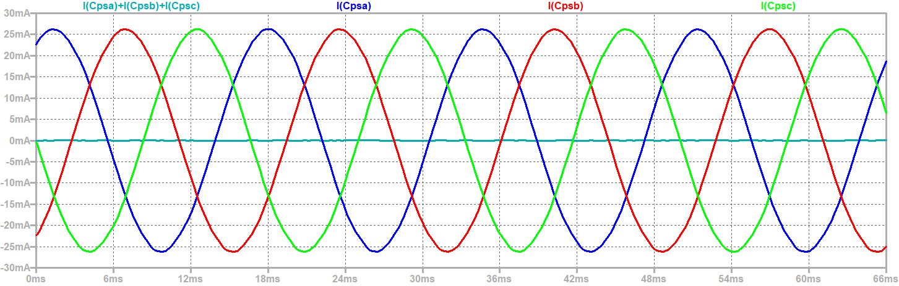

The sum of the currents through the parasitic capacitances is zero (in balanced operation)
$$I_{peak}≈26 mA$$

Slide 13
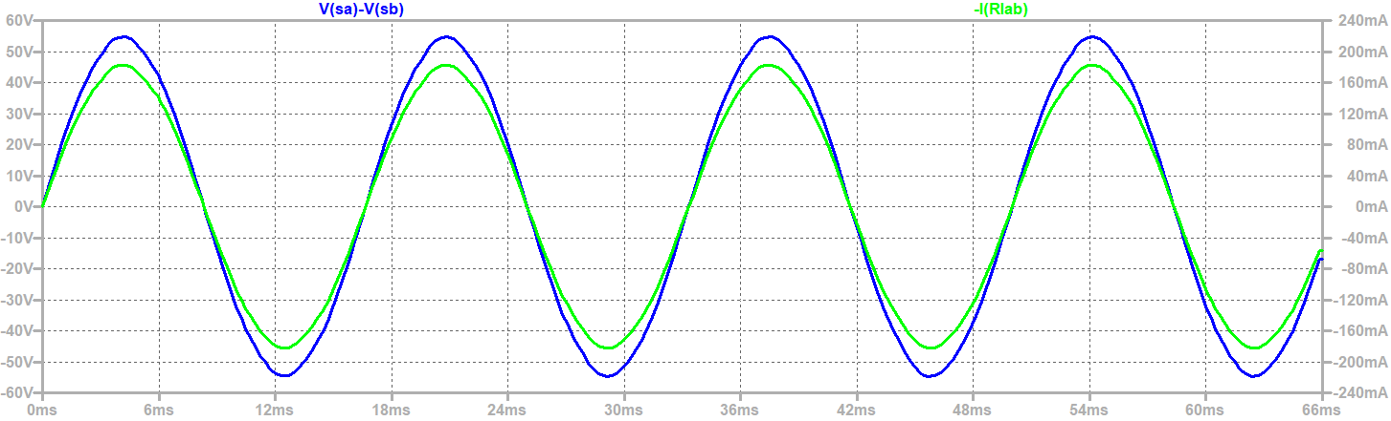

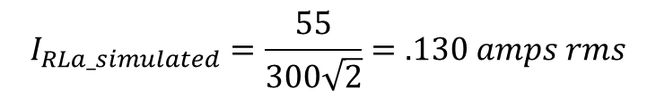
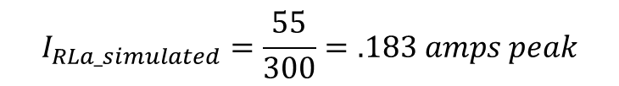
Current in Load Resistor
$$I_{RLa}=\frac{V_{SA }−V_{SB }}{R_{L}}$$
$$I_{RLa_simulated}=\frac{55}{300}=.183 amps peak$$
$$I_{RLa_simulated}=\frac{55}{300\sqrt{2}}=.130 amps rms$$
SA
SB
SC

Slide 14
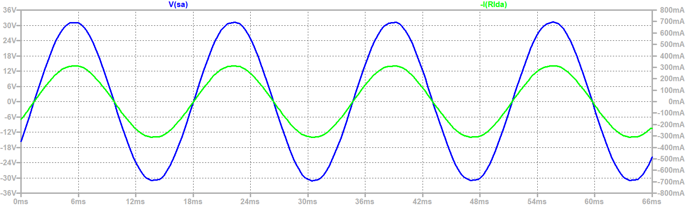



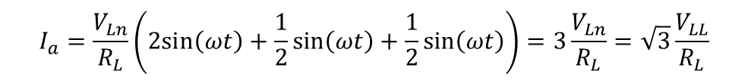
Line current into Delta resistive Load
$$I_{a}=\frac{V_{SA }−V_{SB }}{R_{L}}+\frac{V_{SA }−V_{SC }}{R_{L}}$$
$$I_{a}=\frac{V_{Ln}}{R_{L}}\left(\sin\left(ωt\right)−\sin\left(ωt−\frac{2π}{3}\right)+\sin\left(ωt\right)−\sin\left(ωt+\frac{2π}{3}\right)\right)$$
$$I_{a}=\frac{V_{Ln}}{R_{L}}\left(2sin\left(ωt\right)−\sin\left(ωt\right)\cos\left(−\frac{2π}{3}\right)−\cos\left(ωt\right)\sin\left(−\frac{2π}{3}\right)−\sin\left(ωt\right)\cos\left(\frac{2π}{3}\right)−\cos\left(ωt\right)\sin\left(\frac{2π}{3}\right)\right)$$
$$I_{a}=\frac{V_{Ln}}{R_{L}}\left(2sin\left(ωt\right)+\frac{1}{2}sin\left(ωt\right)+\frac{1}{2}sin\left(ωt\right)\right)=3\frac{V_{Ln}}{R_{L}}=\sqrt{3}\frac{V_{LL}}{R_{L}}$$
$I_{a_calc}=3\frac{V_{Ln}}{R_{L}}$= $3\frac{32}{300}=.32 amps peak$
SA
SB
SC

Slide 15
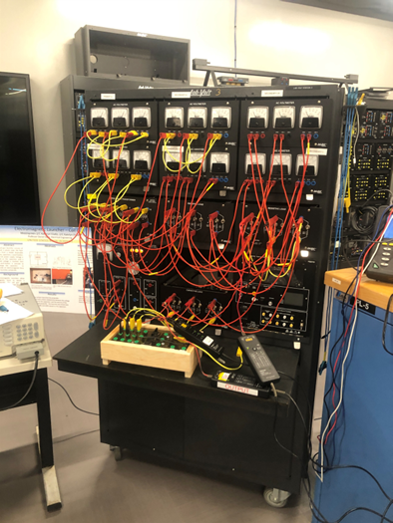
Wrap up

